Slide 1

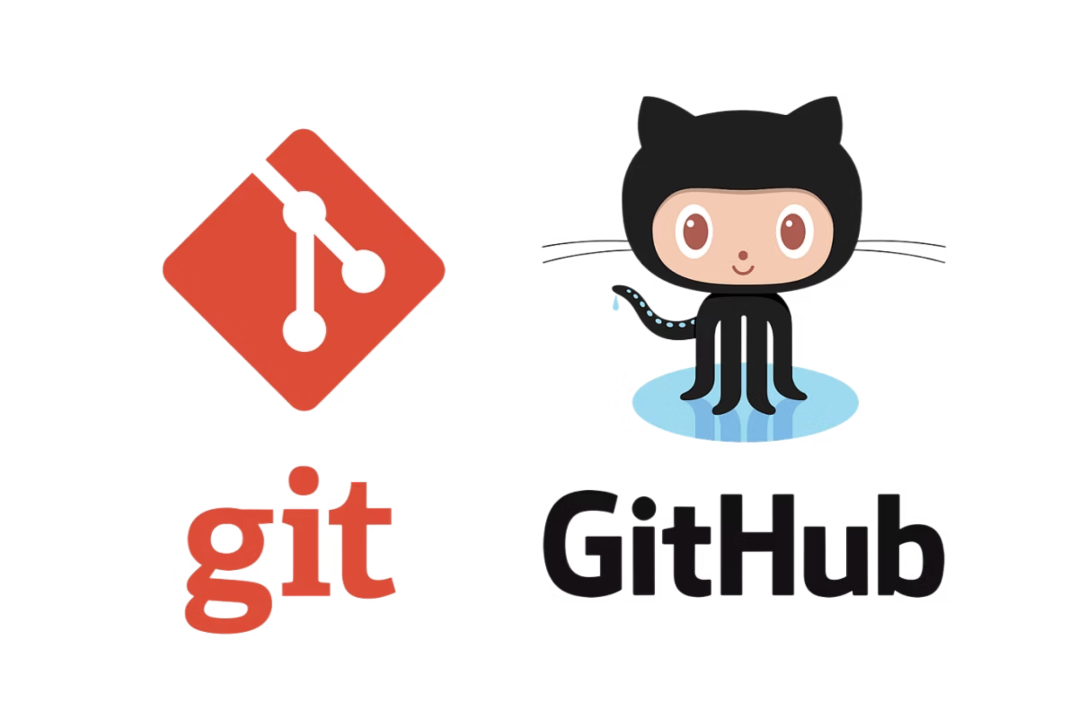
Introduction to Git & GitHub
Version Control for Modern Software Development
Essential tools every developer needs to master
www.herovired.com

Slide 2

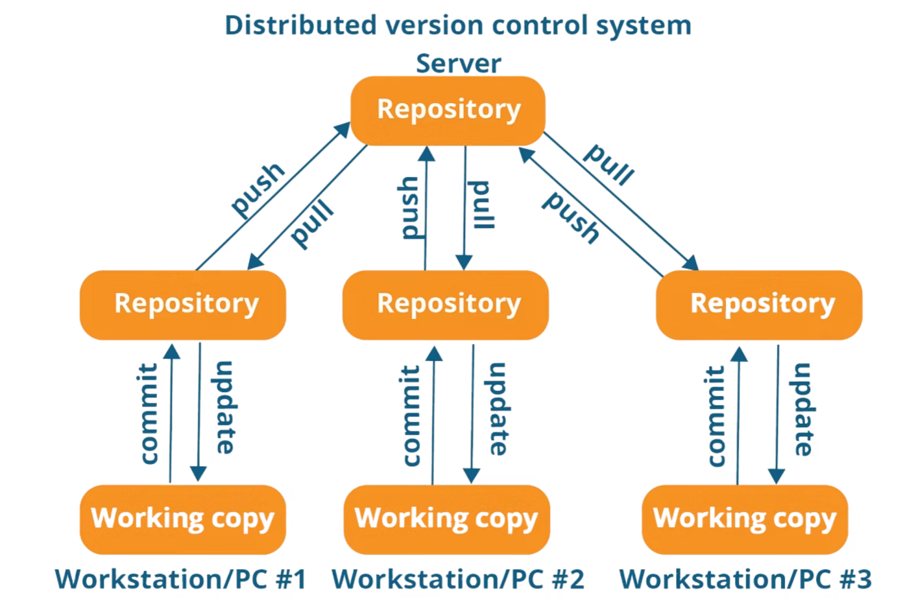
What is Git?
Distributed VCS
Collaboration Power
Git is a Distributed Version Control System that tracks every change in your codebase
Enables seamless teamwork among multiple developers working on the same project
Open Source
Free and created by Linus Torvalds, the same mind behind Linux

Slide 3


Centralized vs Distributed Version Control
Centralized VCS
Distributed VCS
Single central server stores everything
Every developer has a complete copy
Risk of data loss if server fails
More secure and resilient
Requires constant network connection
Works offline
Examples: SVN, Perforce
Faster operations

Slide 4




Why Git is Crucial in Software Development
Team Collaboration
Complete History
Multiple developers can work simultaneously without conflicts, merging changes seamlessly
Every change is tracked with timestamps, authors, and detailed commit messages
Branching & Merging
Safety Net
Create parallel development paths for features, experiments, and bug fixes
Easily rollback to stable versions when bugs are introduced or features don't work
Git has become the industry standard for DevOps workflows and virtually all open-source projects.

Slide 5
Introduction to GitHub
What is GitHub?
Public Repositories
GitHub is a cloud-based platform that hosts Git repositories, making collaboration and code sharing effortless.
Open source projects visible to everyone
Repository Hosting
Private Repositories
Store your Git repositories in the cloud with unlimited public repos
Secure code for personal or enterprise projects
Collaboration Tools
Used by millions of developers worldwide for both open-source contributions and enterprise development.
Issues tracking, pull requests, project boards, and team management

Slide 6
Creating GitHub Account & Repository
01
02
03
Create GitHub Account
New Repository
Repository Details
Sign up at github.com with your email and choose a memorable username
Click the "+" icon and select "New repository" from your dashboard
Choose a descriptive name and add a brief description of your project
04
05
Visibility Settings
Initialize Options
Select Public (open source) or Private (restricted access) based on your needs
Add README.md for documentation, .gitignore for excluded files, and choose an appropriate license

Slide 7

Git Ignore & Basic Settings
.gitignore File
Pro tip: GitHub provides template .gitignore files for popular programming languages and frameworks!
Tells Git which files and folders to exclude from tracking. Essential for keeping repositories clean.
Log Files
Dependencies
Application logs that change frequently
node_modules, vendor folders
Sensitive Data
API keys, passwords, config files
Basic Git Configuration
git config --global user.name "Your Name"
git config --global user.email "you@example.com"

Slide 8
Essential Git Commands
Initialize Repository
Check Status
Commit Changes
git init
git status
git commit -m "message"
Creates a new Git repository in your current directory
Shows which files have been modified, added, or deleted
Saves staged changes with a descriptive message
1
2
3
4
5
6
Clone Repository
Stage Changes
Push & Pull
git clone <url>
git add . or git add <file>
git push origin main
git pull origin main
Downloads a repository from GitHub to your local machine
Prepares files for commit (adds to staging area)
Upload changes to GitHub or download latest updates

Slide 9





Hands-On Practice Exercises
Create & Connect
Set up a local Git repository and link it to a new GitHub repository
First Commit
Create a new file with content, stage it, commit with a message, and push to GitHub
Make Changes
Edit your file, commit the changes, and push the updates to see version history
Sync Updates
Practice pulling the latest changes from your GitHub repository to stay synchronized
Ignore Files
Add a .gitignore file and test that excluded files don't get tracked by Git

Slide 10

Wrap Up & Next Steps
Git Foundation
GitHub Platform
You now understand Git as a powerful version control system for tracking code changes
GitHub provides the collaboration tools and hosting to work effectively with teams
Key Benefits Mastered
Complete project history and change tracking
Seamless team collaboration and code sharing
Safe experimentation with easy rollback options
Access to the world's largest open-source community
Coming Next: Advanced topics including branching strategies, merging techniques, pull request workflows, and collaborative development patterns

Slide 11

Thank You
www.herovired.com
Wait Nahi, Great Kar!

